Slide 1
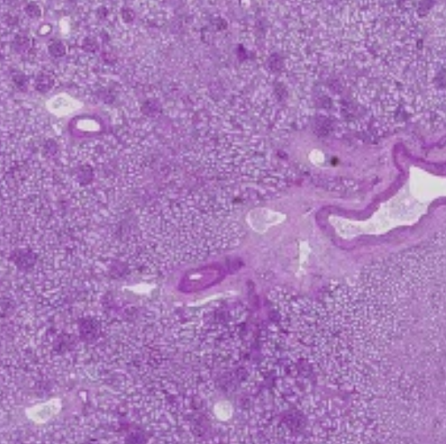
Visualizing Renal Glomerular Characteristics Relative to Patient Metadata
ENGR-E583 Visual Analytics
Indiana University Bloomington
Spring 2023
Amanda Alonzo
Saranjeet Saluja
John Savage
Chunlin Yang

Slide 2
Introduction
Project Goal:
Visualize and identify relationships between clinical metadata including weight, height, gender, race, and age to the characteristics of the renal image including size, number, and shape of the glomeruli.
Project Importance:
Discover deeper knowledge about how the kidney works
Identify relationships and variation across to patient samples
Understand the potential of applying data analytics to medical imaging
Support medical research and clinical decision support

Slide 3
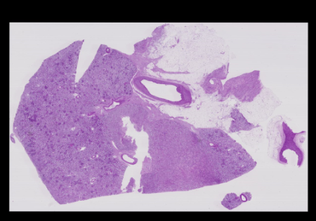
Background: Glomeruli & Cortex
Key Medical Terms:
Glomeruli are the high functioning clusters of capillaries in the kidney responsible for cleaning the blood and filtering the waste
The kidney is composed of the outer cortex which contains the glomeruli, and the inner medulla which houses other cells for expelling the waste and processing urine.

Slide 4

Related Work
Take-Away Findings from Past Research:
The relationship between age or body mass index (BMI) and glomeruli number may be negatively correlated.
Glomeruli number and gender or race should not have a statistically significant relationship.
Glomerular count and volume should be negatively correlated
Past Studies
[1] Hughson, M., Farris, A.B., Douglas-Denton, R., Hoy, W.E., & Bertram, J.F. (2003).
Glomerular number and size in autopsy kidneys: The relationship to birth weight.
[2] Nyengaard, J.R. & Bendtsen, T.F. (1992).
Glomerular Number and Size in Relation to Age, Kidney Weight, and Body Surface in Normal Man.
[3] Hoy, W.E., Douglas-Denton, R.N., Hughson, M.D., Cass, A., Johnson, K., & Bertram, J.F. (2003).
A stereological study of glomerular number and volume: Preliminary findings in a multiracial study of kidneys at autopsy.
* See References for full details

Slide 5
Raw Data
Source:
Kaggle competition train and test data for patients and kidney images
HuBMAP Human Atlas project of samples
20 kidney tissue section images
15 in the train data set and 5 in the test dataset
11 unique patients (some patients have multiple samples)
Very large (>500MB - 5GB) TIFF image files
Corresponding Anatomical Structure segmentation and Glomeruli segmentation mask
JSON format
Detailed polygon coordinates to represent each glomerulus in the kidney sample
Patient metadata is provided in the “HuBMAP-20-dataset_information.csv” including
Age, race, gender, height, weight, kidney laterality, etc.
Image width and height in pixels
Notes:
Human BioMolecular Atlas Program
An open, global atlas of the human body at the cellular level The HuBMAP Data Portal is the central resource for discovery, visualization, and download of single-cell tissue data generated by the consortium.

Slide 6

Initial Calculations Performed
Area of the Cortex and Glomeruli using the Shoelace Formula that takes polygon vertices and sums up the area of contained trapezoids
The images fall into 2 sets with 2 different scales:
Scale of 1 square pixel = 0.25 microns (0.5 by 0.5)
Scale of 1 square pixel = 0.4225 (0.65 by 0.65)
Glomeruli Eccentricity to measure the shape of with 0 as a perfect sphere and 1 as elongated ellipse using major and minor axes
Each axis determined by: Max x – Min x and Max Y – Min Y; The larger of the 2 considered the major axis;
Where “a” is semi-major axis length and “b” is semi-minor axis length
Body Surface Area (BSA) calculated from patient and weight as alternative to Body Mass Index (BMI)
Notes:
Human BioMolecular Atlas Program
An open, global atlas of the human body at the cellular level The HuBMAP Data Portal is the central resource for discovery, visualization, and download of single-cell tissue data generated by the consortium.

Slide 7
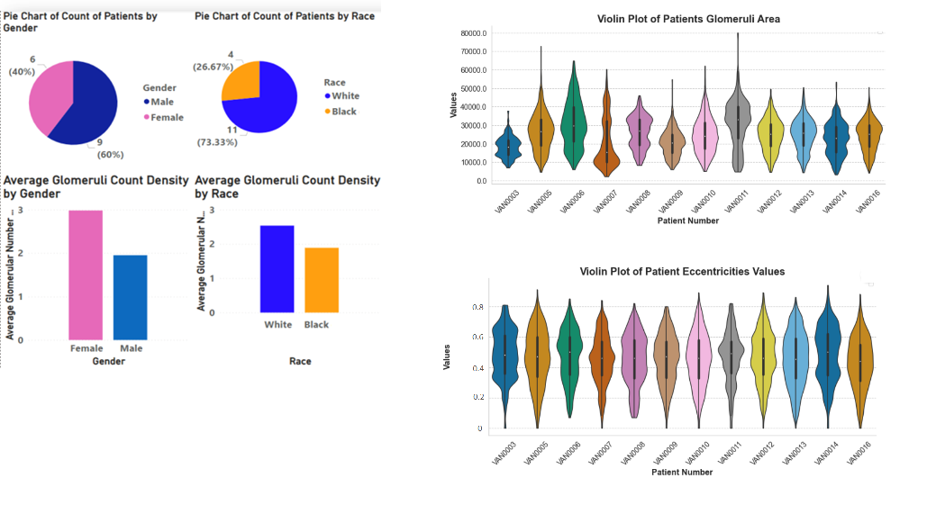
Insight : Initial Data Analysis
Low number of samples with no samples for female black patients
More samples for males as well as whites
Higher number of low area glomeruli across patients
Even distribution of eccentricity shape across patients

Slide 8
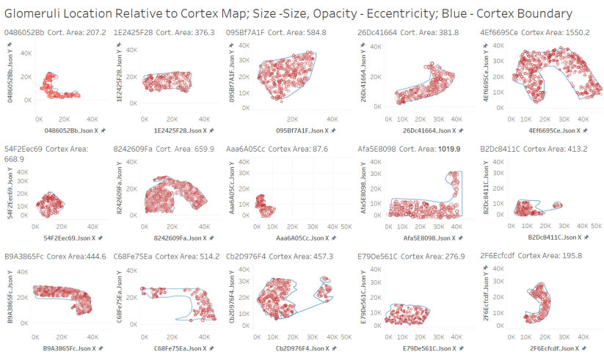
Insight: Variation of Samples across Patients
Variation is too great for comparison of raw counts or areas

Slide 9
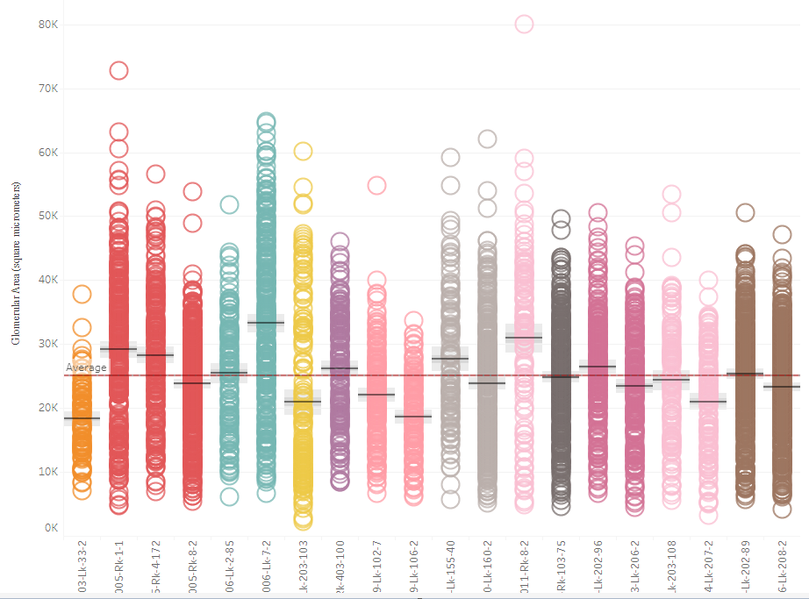
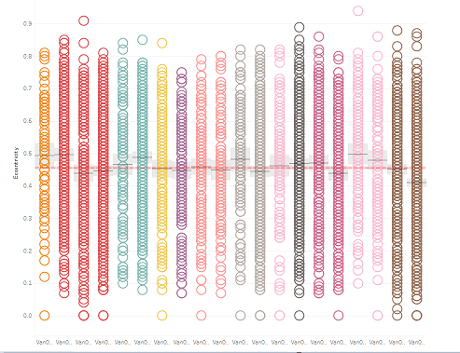
Area by Patient
Eccentricity by Patient
Insight: Variation of Samples for Same Patient
Multiple samples for same patient have variation due to angle and sample taken

Slide 10
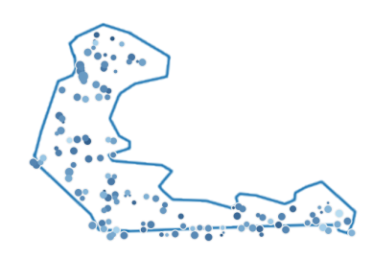
Transformed Data for Comparison
Due to the wide variation in samples:
For each image, the glomeruli properties were derived in relation to the size of the cortex
This way, a sample with a small segment of cortex can be compared to a sample with a larger segment of cortex based on ratio
Notes:
Human BioMolecular Atlas Program
An open, global atlas of the human body at the cellular level The HuBMAP Data Portal is the central resource for discovery, visualization, and download of single-cell tissue data generated by the consortium.

Slide 11
Additional Calculations Performed
Glomerular Count Density
Number of glomeruli per square millimeter of the cortex
Glomerular Area Density
Sum area of all the glomeruli divided by the area of the cortex in the sample
Notes:
Human BioMolecular Atlas Program
An open, global atlas of the human body at the cellular level The HuBMAP Data Portal is the central resource for discovery, visualization, and download of single-cell tissue data generated by the consortium.

Slide 12
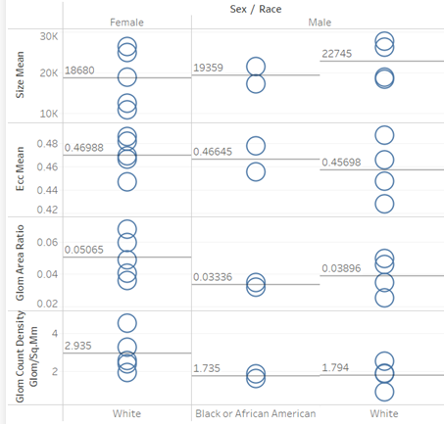
Insight: Metadata Without Glomerular Relationship
Sex, Race, and BMI or BSA Do Not Have Significant Relationship to Glomerular area or count density

Slide 13
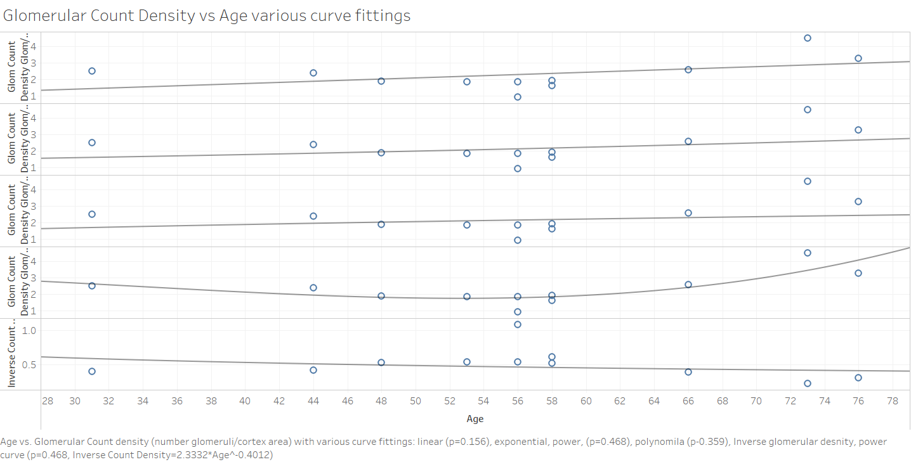
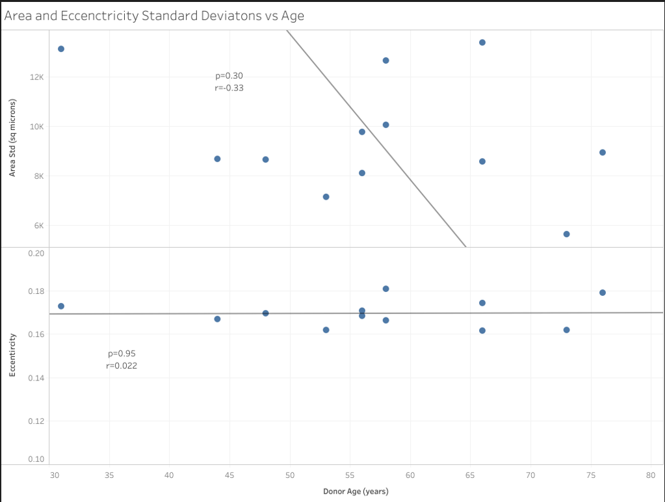
Insight: Age is Related to Glomerular Metrics
There is strong evidence that glomerular size decreases with age (p=0.031).

Slide 14
Background: GFR & MDRD
Key Medical Terms:
Glomerular Filtration Rate (GFR) is measure of kidney functioning in terms of ability to effectively filter.
Modification of Diet in Renal Disease (MDRD) is a formula for estimating GFR as a function of age, sex, race, and creatinine level
GFR in mL/min per 1.73 m² = 175 x SerumCr^{-1.154} x age^{-0.203} x 1.212 (if patient is black) x 0.742 (if female)
Our project’s data includes no values for creatinine, so the remainder of the MDRD equation will be compared to the derivation based on the image data. This simplifies the MDRD factor:
MDRD Factor: age^{-0.203} x 1.212 (if the patient is black) x 0.742 (if female)
The analogous models for the MDRD Factor from the image-derived data are:
age^{-0.392695} x 1.1264(if black) x 0.8818 (if female)
derived from glomerular area ratio data
age^{-0.392695} x 1.127 (if black) x 0.7907 (if female)
derived from glomerular density data

Slide 15
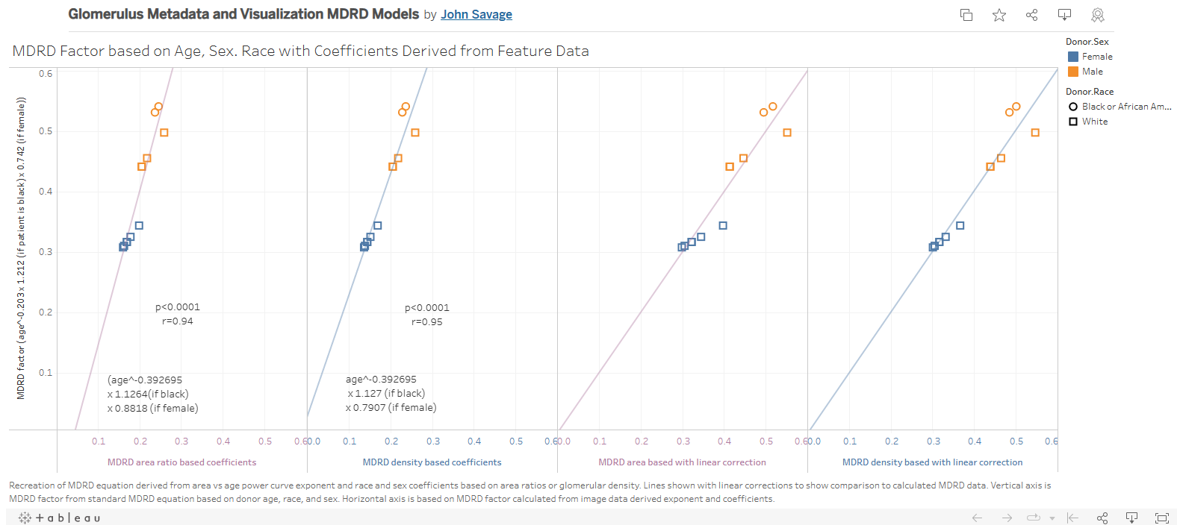
Insight: Glomerular Metrics related to MDRD Models
There is high level of significance and good accuracy of MDRD Factor based on dataset features
This significance of the glomerular area function is due to high correlation with respect to age and the linear combination of the coefficients for race and sex.

Slide 16
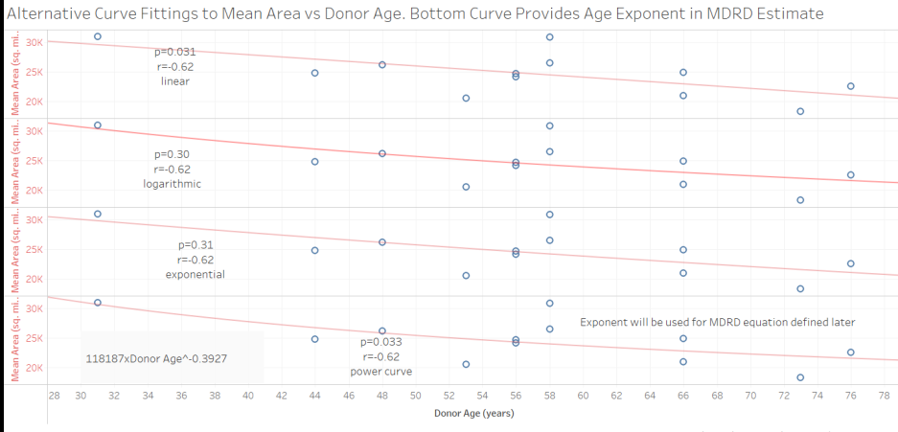
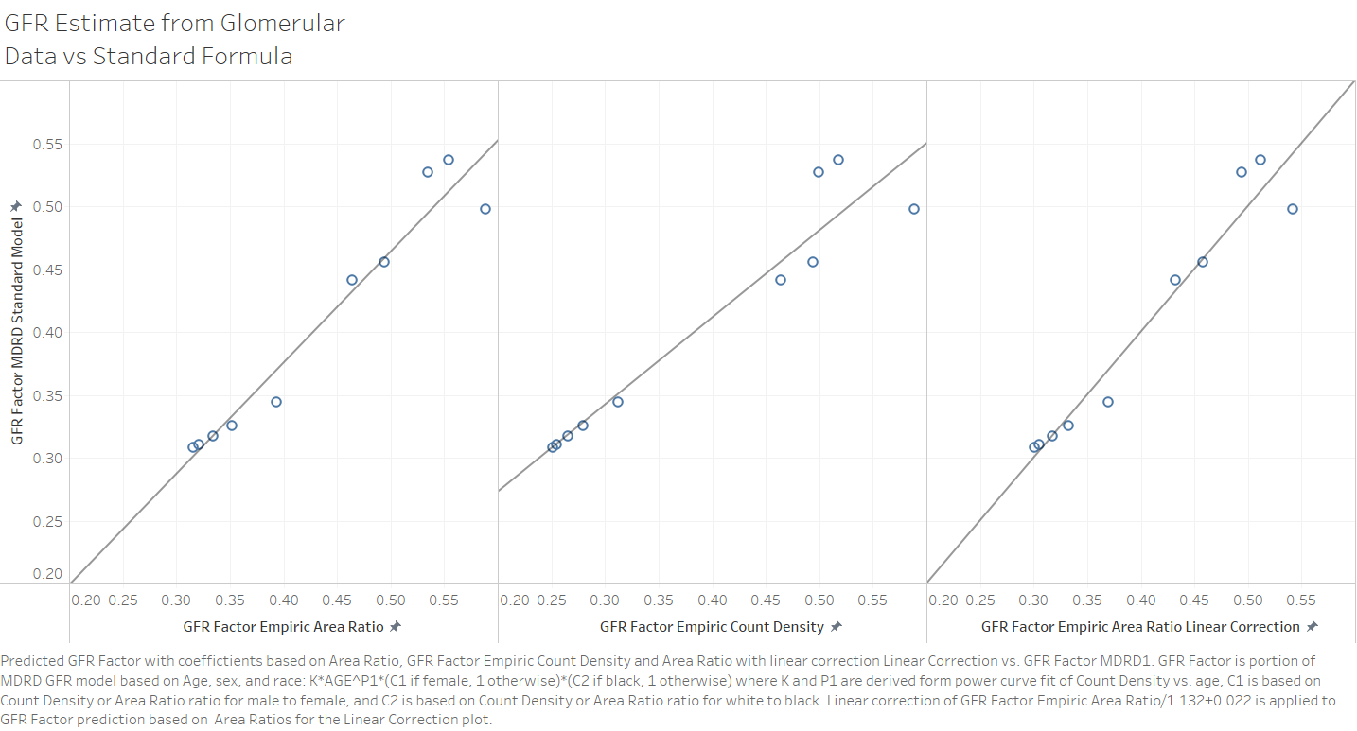
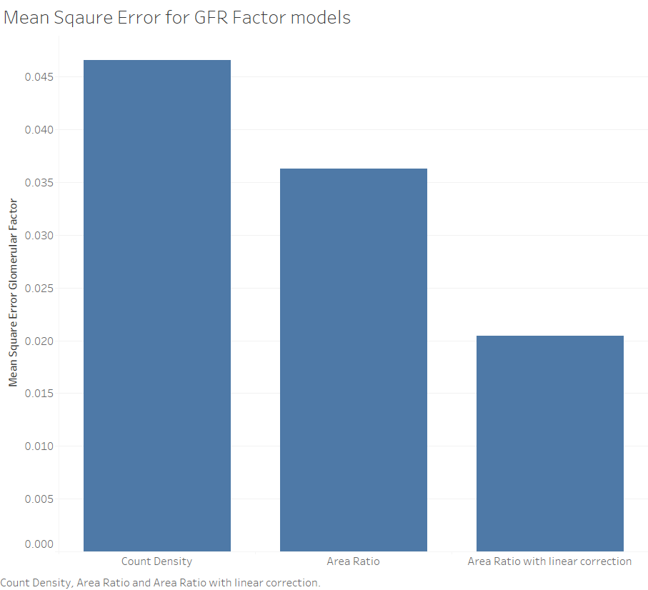
Insight: Glomerular Filtration Rate (GFR) is related to Age with formula
An equation analogous to a portion of the MDRD equation could be derived from values measured from the images using the power curve for glomerular size vs age and ratios of the glomerular density for sex and race.
The coefficients derived from the glomerular density data are closest to the MDRD equation and this is demonstrated in figure above.
These derivations of the analogous MDRD equations were accurate despite the limited data (p<0.0001, rmse=6.8%).
Models compared by Mean Square Error shows Area Ratio with linear correction has least error and the maximum error after linear correction is less than 10% for any point.

Slide 17
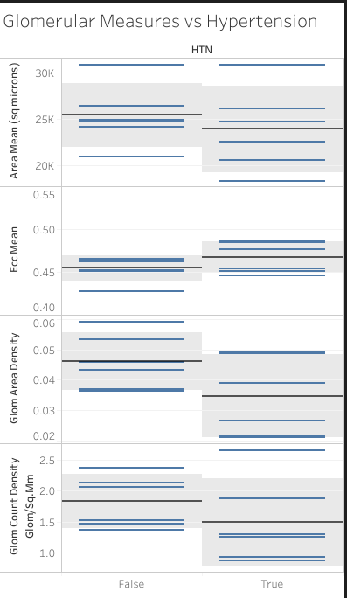
Hypertension Insight: Potential relationship between hypertension and glomerular metrics with result extremely close to significance level Consistent with what might be expected with loss of renal function over time related to hypertension.

Slide 18
Challenges and Solutions
Samples cover different portions and distributions of the kidney
Solution: Combine duplicate patient pairs as this would likely make the combined data sample closer to the true data and would not bias the metadata by duplication of patients.
Samples cover a large variation in the number of glomeruli
Solution: Replace counts with densities of glomerular metric relative to cortex within the image
Small number of samples
Solution: Matching the data of area ratio and glomerular density to sex, race, and age and applying this data to an analog of the MDRD equation to estimate Glomerular Filtration Rate, the accepted measure of renal function, there were very low p values when correlating with the MDRD equation.
Solution: Obtained more data from HubMAP
Missing Data
Solution: Obtain data from alternate source
Patient Data does not have clinical values
Solution: Obtain GFR estimates without creatinine
Solution: Obtain hypertension, cancer diagnosis data from alternate source

Slide 19
Opportunities
Explore methods for standardized sampling
Process raw TIFF images files
Obtain broader and higher volume of data for longitudinal comparison, younger age range
Consider alternate non-invasive imaging techniques
Include clinical meta data such as disease diagnosis, GFR, and creatinine lab values

Slide 20
Acknowledgements
Course Professors, Teaching Assistants, Classmates, Lecturer
Shriya Mandarapu for client advice
Jess Spraggins, Vanderbilt University, is thanked for providing the dataset
Nathan Patterson and Elisabeth Neumann for their effort in annotating the images.

Slide 21
References
[1] Hughson, M., Farris, A.B., Douglas-Denton, R., Hoy, W.E., & Bertram, J.F. (2003). Glomerular number and size in autopsy kidneys: The relationship to birth weight. Kidney International, 63, 2113-2122. Jackson, MS: University of Mississippi Medical Center; Clayton, Victoria, Australia: Department of Anatomy and Cell Biology, Monash University; Brisbane, Australia: Centre for Chronic Disease, University of Queensland.
[2] Nyengaard, J.R. &Bendtsen, T.F. (1992). Glomerular Number and Size in Relation to Age, Kidney Weight, and Body Surface in Normal Man. The Anatomical Record, 232, 194-201. Aarhus, Denmark: Stereological Research Laboratory, University Institute of Pathology and 2nd. University Clinic of Internal Medicine, Institute of Experimental Clinical Research, Aarhus University.
[3] Hoy, W.E., Douglas-Denton, R.N., Hughson, M.D., Cass, A., Johnson, K., & Bertram, J.F. (2003). A stereological study of glomerular number and volume: Preliminary findings in a multiracial study of kidneys at autopsy. Kidney International, 63(Suppl 83), S31-S37. Darwin, Northern Territory, Australia: Renal Unit, Menzies School of Health Research; Melbourne, Victoria, Australia: Department of Anatomy and Cell Biology, Monash University; Jackson, Mississippi, USA: Department of Pathology, University of Mississippi Medical Center.
[4] Andrew S. Levey, MD, Josef Coresh, MD, PhD, MHS, Tom Greene, PhD, Lesley A. Stevens, MD, MS, Yaping (Lucy) Zhang, MS, Stephen Hendriksen, BA, John W. Kusek, PhD, & Frederick Van Lente, PhD (15 August 2006). Using Standardized Serum Creatinine Values in the Modification of Diet in Renal Disease Study Equation for Estimating Glomerular Filtration Rate, Annals of Internal Medicine, Volume 145, Issue 4, 247-254, https://doi.org/10.7326/0003-4819-145-4-200608150-00004.
[5] Leah L. Godwin, Yingnan Ju, Naveksha Sood, Yashvardhan Jain, Ellen M. Quardokus, Andreas Bueckle, Teri Longacre, Aaron Horning, Yiing Lin, Edward D. Esplin, John W. Hickey, Michael P. Snyder, N. Heath Patterson, Jeffrey M. Spraggins, Katy Börner. 2021. “Robust and generalizable segmentation of human functional tissue units.”bioRxiv 2021.11.09.467810; doi: 10.1101/2021.11.09.467810 .

Slide 22
References – External Sites
Dataset: https://www.kaggle.com/c/hubmap-kidney-segmentation/data
Kaggle Competition: https://www.kaggle.com/c/hubmap-kidney-segmentation
Dataset Details: https://www.kaggle.com/leahscherschel/dataset-details
Glomeruli Detection Related Works: https://www.kaggle.com/leahscherschel/glomeruli-detection-related-works
Shoelace Formula: https://en.wikipedia.org/wiki/Shoelace_formula

